Slide 1
Discussion 12
Greedy Algorithms

Slide 2
Objectives
Optimization problems
Greedy strategies
When to use greedy algorithms?
Huffman’s Algorithm
Example - Graph coloring

Slide 3
TA Evaluations
Please fill out the TA Evaluation Google Form so we can improve the course!
https://forms.gle/C16UVAZWv8ELoqSa6

Slide 4
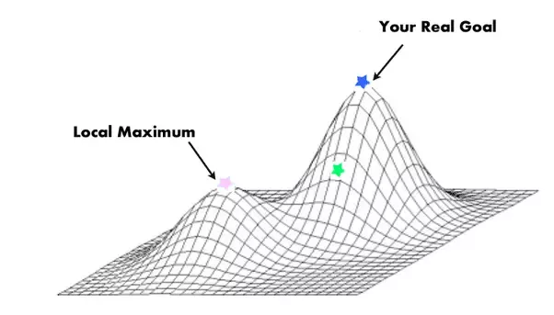
Optimization problems
In optimization problems, we want to find the best solution.
Ex: Image classification algorithms want to minimize the percentage of images they classify incorrectly.
Algorithms that solve optimization problems typically go through a series of steps, trying to produce an optimal solution at the end.
Q: How should my algorithm make decisions to produce an optimal solution?

Slide 5

One answer: greedy algorithms
Make the choice that looks best at every step.
Hope that picking the best-looking choice each time results in the overall best answer.
We call these strategies for picking optimal choices greedy strategies.
Ex:
Currently standing at the top of a tall hill.
Want to end up at ground level.
Greedy strategy: walk one foot in whatever direction is steepest downhill.

Slide 6
Poll Question #1
You are packing standard sized delivery trucks with packages of various sizes. A conveyor transports the packages to you. Pick all of the greedy strategies for packing the packages into the minimal number of trucks.
Throw each package into a random truck.
Wait until you have all the packages, then think through all possible combinations of packages in trucks and select the optimal combination.
For each package, scan the partially filled trucks and place the package in the truck with the most open space. If none of the partially filled trucks have enough room for the package, then put the package into a new truck.

Slide 7
Poll Question #1
You are packing standard sized delivery trucks with packages of various sizes. A conveyor transports the packages to you. Pick all of the greedy strategies for packing the packages into the minimal number of trucks.
Throw each package into a random truck. Random choices are not locally optimal!
Wait until you have all the packages, then think through all possible combinations of packages in trucks and select the optimal combination. Exhaustive searches over all possible combinations =/= a series of locally optimal choices.
For each package, scan the partially filled trucks and place the package in the truck with the most open space. If none of the partially filled trucks have enough room for the package, then put the package into a new truck. Involves making a reasonable optimal choice at each step, so this strategy is greedy.

Slide 8
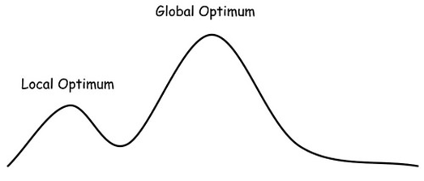
When are greedy algorithms effective?
Most effective when a series of locally optimal choices always leads to the globally optimal choice.
Huffman trees
Dijkstra’s shortest path algorithm
Some greedy algos just approximate the optimal solution.
Traveling Salesman Problem - find the shortest tour through a positively-weighted graph.
Exact solution: O(2^n * n^2).
Greedy approximation: O(n^2 logn) within 1.5x the optimal solution.
In this situation, an optimization routine might approach the local optimum, but not the global one!
Notes:
TSP: Fastest exact algorithm is exponential, but fast greedy algorithms exist

Slide 9
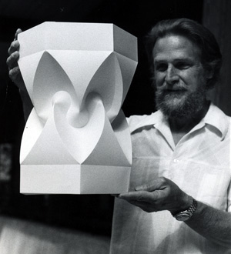
Huffman trees
Solves the optimization problem to compress a file into the minimum number of bits.
A full binary tree where each leaf corresponds to a character.
We collect the frequency of different characters and build a tree whose paths represent characters:
Characters with larger frequencies have shorter distances from root.
Branching left or right from a given node represents a 0 or 1, respectively. The path taken to arrive at a character’s leaf node is that character’s huffman encoding.
Use case: lossless data compression.
David A. Huffman

Slide 10
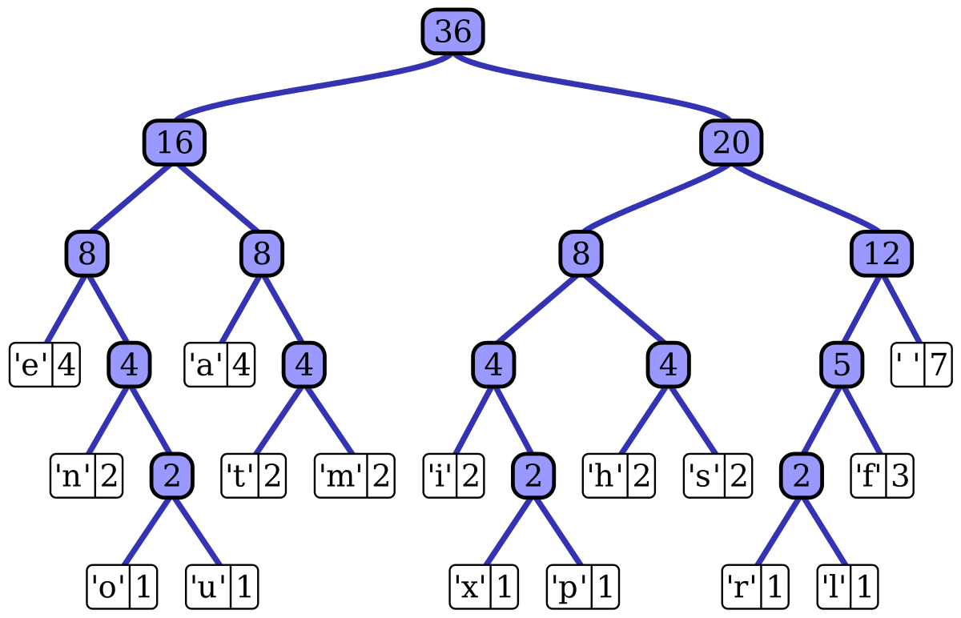
Huffman tree generated from this sentence:
“this is an example of a huffman tree”

Slide 11
Huffman trees are greedy
Huffman codes are greedy in the sense that the most frequent letters get the shortest encoding.
Huffman codes solve the problem of finding the optimal encoding. Note that the code depends on the text given to construct the huffman tree.
We want to have shorter codes / shorter paths / fewer parents for characters with very high counts, and we are alright with having many parents for characters with lower counts.
Notes:
Could possibly just turn this into a poll question

Slide 12
Pseudocode for building a Huffman tree
Procedure Huffman(C): // C is the set of n characters and their frequencies
n = C.size
Q = priority_queue() // Min Heap
for i = 1 to n
x = node(C[i]) // Construct nodes that contain their symbols and their weight (frequency)
Q.push(x) // Place the nodes in a priority queue
end for
while Q.size() is greater than 1 // loop while Q has more than 1 item
Z = new node() // Make new Huffman tree node
Z.left = x = Q.pop // remove the 2 trees with smallest weights and create new binary tree
Z.right = y = Q.pop
Z.freq = x.freq + y.freq // the root is the sum of its children’s weights
Q.push(Z) // Insert the newly created tree back into Q
end while
Return Q.top() // Return tree, it can now be traversed to obtain binary codes for characters

Slide 13
Huffman example
Given a 100,000-character data file:
+------------------------+-----+-----+-----+-----+-----+-----+
| Character | a | b | c | d | e | f |
+------------------------+-----+-----+-----+-----+-----+-----+
|Frequency (in thousands)| 45 | 13 | 12 | 16 | 9 | 5 |
+------------------------+-----+-----+-----+-----+-----+-----+
Resulting codes from Huffman Tree:
+----------------+-----+-----+-----+-----+-----+-----+
| Character | a | b | c | d | e | f |
+----------------+-----+-----+-----+-----+-----+-----+
| Codes | 0 | 101 | 100 | 111 | 1101| 1100|
+----------------+-----+-----+-----+-----+-----+-----+

Slide 14
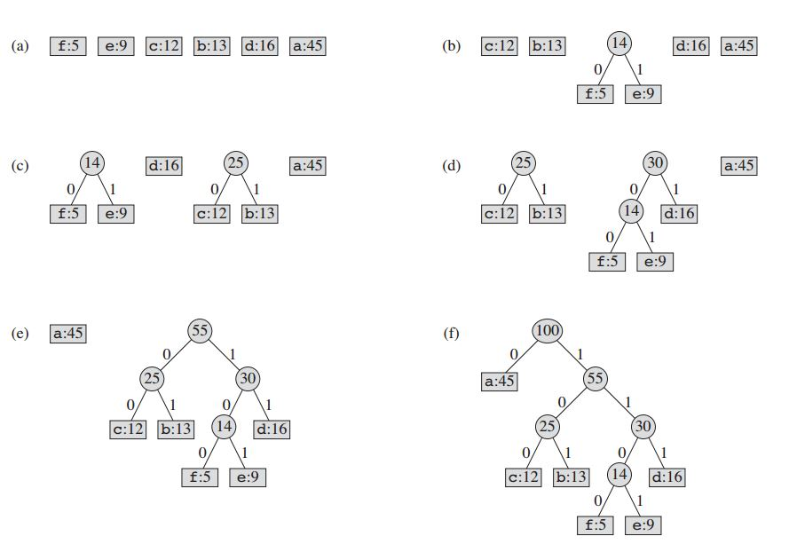

Slide 15
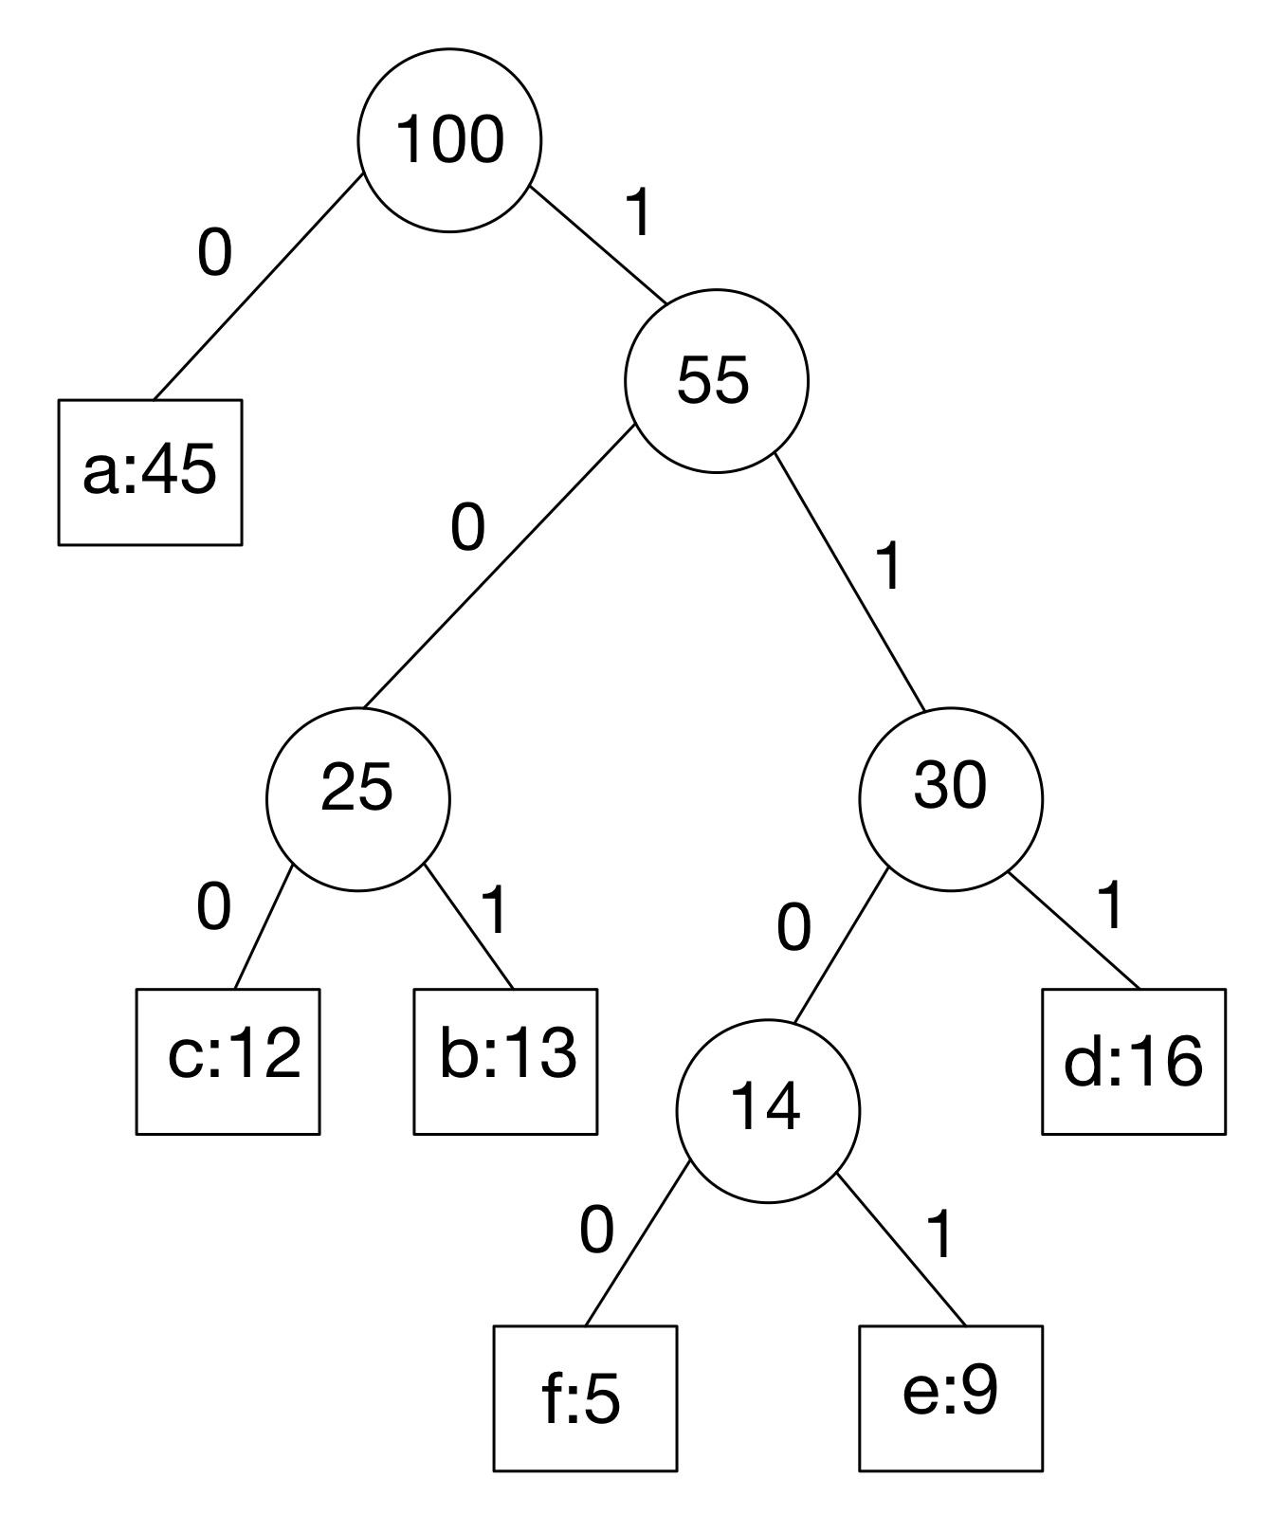
Poll Question #2
Which is the proper encoding of “face” and decoding of “01011101”?
Encoding of “face”: 110001001110
Decoding: abe
Encoding of “face”: 011001001101
Decoding: be
Encoding of “face”: 1110101
Decoding: bad
Encoding of “face”: 110001001101
Decoding: abe

Slide 16
Poll Question #2
Which is the proper encoding of “face” and decoding of “01011101”?
Encoding of “face”: 110001001110
Decoding: abe
Encoding of “face”: 011001001101
Decoding: be
Encoding of “face”: 1110101
Decoding: bad
Encoding of “face”: 110001001101
Decoding: abe

Slide 17
Poll Question #3
Which of the following statements explain how huffman trees are greedy? Pick all that apply:
Huffman trees can only contain characters.
The most frequently used characters get the shortest encoding.
Huffman trees use a max heap to solve the problem.
The Huffman algorithm is recursive.

Slide 18
Poll Question #3
Which of the following statements explain how huffman trees are greedy? Pick all that apply:
Huffman trees can only contain characters.
The most frequently used characters get the shortest encoding.
Huffman trees use a max heap to solve the problem.
The Huffman algorithm is recursive.

Slide 19
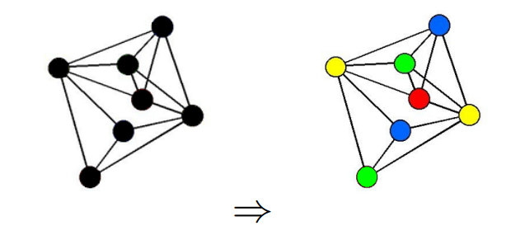
Graph coloring problem
Problem statement:
How can we assign a color to every node of a graph such that no two nodes which share an edge also share the same color? How do we do this with as few colors as possible?

Slide 20
Problem information
The colors are ranked as such:
0 - RED
1 - BLUE
2 - GREEN
3 - YELLOW
4 - ORANGE
5 - PURPLE
The first node should be assigned red, next blue and so on.
The function you will make will take a reference to the following graph:
class Graph {
public:
// The adjacency list
vector<vector<int>> adjList;
// The number of vertices in the graph
int V;
// The constructor
Graph(...) {...}
}

Slide 21
Problem information
Method signature: std::vector<string> color(Graph &graph) {}
The method takes in a reference to the graph object.
The method will return a vector of strings, in upper case, denoting the colors of the nodes in the order that was given in the Graph class’s adjList member.
Constraints
The graph is undirected and will always be connected
1 <= V <= floor(sqrt(INT_MAX))
1 <= E <= V(V-1)/2

Slide 22
Now let’s tackle the problem, coding interview style!

Slide 23
Approach
State brute force, brief explanation
State faster greedy approach
Work through example
State pseudo code, explanation
Build C++ code
Discussion, list runtime and explanation

Slide 24
Brute force
We can go through all combinations of k colors for the graph where k = 1,2,3,.., |V|-1.
We can check each combination until we find the first valid solution.
This solution’s runtime will increase exponentially: O(n*2^n)
As the graph size increases, after a certain point, getting the most optimal solution is impractically slow.
This calls for a greedy strategy: we can sacrifice having the optimal solution for one that is “good enough” and findable in polynomial time.

Slide 25
Greedy approach
Start at first vertex and one by one assign a color by checking for the first color in the list not assigned to a neighboring vertex.
By doing this, we are finding the locally optimal path for each step.
This should solve our problem way quicker!

Slide 26
Example
Graphs will be inputted as a vector of edges.
Ex: [[0,1], [0,4], [0,5], [4,5], [1,4], [1,3], [2,3], [2,4]]
Output:
Vertex 0: RED
Vertex 1: BLUE
Vertex 2: RED
Vertex 3: GREEN
Vertex 4: GREEN
Vertex 5: BLUE

Slide 27
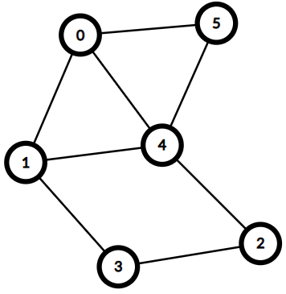
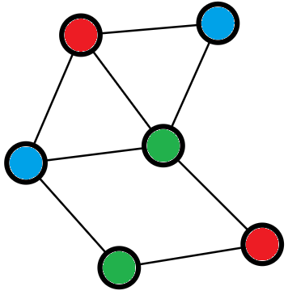
Example
We are confident our result has no two adjacent nodes that share the same color:
=>

Slide 28
Color ranks:
0 - RED
1 - BLUE
2 - GREEN
3 - YELLOW
4 - ORANGE
5 - PURPLE
5
0
0
4
1
Current node: 0
Node 0 has no marked neighbors, so we color it red.
2
3

Slide 29
Color ranks:
0 - RED
1 - BLUE
2 - GREEN
3 - YELLOW
4 - ORANGE
5 - PURPLE
5
0
4
1
1
Current node: 1
Node 1 has a marked neighbor.
Color it the next available color from ranks.
2
3

Slide 30
Color ranks:
0 - RED
1 - BLUE
2 - GREEN
3 - YELLOW
4 - ORANGE
5 - PURPLE
5
0
4
1
1
Current node: 2
Node 2 has no marked neighbors, so we color it red
2
2
3

Slide 31
Color ranks:
0 - RED
1 - BLUE
2 - GREEN
3 - YELLOW
4 - ORANGE
5 - PURPLE
5
0
4
1
1
Current node: 3
Node 3 has two marked neighbors.
Color it the next available color from ranks.
2
2
3
3

Slide 32
Color ranks:
0 - RED
1 - BLUE
2 - GREEN
3 - YELLOW
4 - ORANGE
5 - PURPLE
5
0
4
4
1
1
Current node: 4
Node 4 has three marked neighbors.
Color it the next available color from ranks.
2
2
3
3

Slide 33
Color ranks:
0 - RED
1 - BLUE
2 - GREEN
3 - YELLOW
4 - ORANGE
5 - PURPLE
5
5
0
4
4
1
1
Current node: 5
Node 5 has two marked neighbors.
Color it the next available color from ranks.
2
2
3
3

Slide 34
Color ranks:
0 - RED
1 - BLUE
2 - GREEN
3 - YELLOW
4 - ORANGE
5 - PURPLE
5
5
0
4
4
1
1
Done, we have colored all nodes accordingly!
Output:
Vertex 0: RED
Vertex 1: BLUE
Vertex 2: RED
Vertex 3: GREEN
Vertex 4: GREEN
Vertex 5: BLUE
2
2
3
3

Slide 35
Poll Question #4
0
1
2
What statements are true about the graphs?
Graph A and B have valid graph colorings.
Neither graphs have valid graph colorings.
Graph A does not have a valid graph coloring while Graph B does.
Graph A has a valid graph coloring while Graph B does not.
3
Graph A
0
1
2
3
Graph B

Slide 36
Poll Question #4
0
1
2
What statements are true about the graphs?
Graph A and B have valid graph colorings.
Neither graphs have valid graph colorings.
Graph A does not have a valid graph coloring while Graph B does.
Graph A has a valid graph coloring while Graph B does not.
3
Graph A
0
1
2
Explanation: No adjacent vertices can share the same color for a graph to have a valid graph coloring. Graph A satisfies this condition while Graph B does not. We can repeat colors so long as those vertices do not touch.
3
Graph B

Slide 37
Graph coloring - greedy pseudocode
The greedy algorithm for graph coloring is as follows:
Color the starting vertex with the first color.
For all remaining vertices:
If all the colors used before are present in the adjacent vertices:
Make a new color and assign it to that vertex.
Else:
Color it with a color that has been used before but is not the color of any adjacent vertex.

Slide 38
Basic idea to solve graph coloring
We will solve this problem in 3 basic steps:
Initialization
Color the graph
Return vertex colors as vector
std::vector<string> color(Graph &graph) {
// INITIALIZATION
// make variables/containers we will use
// COLOR GRAPH
// loop through vertices
// for each vertex assign next available color
// update containers/ keep track of colors
// RETURN VECTOR OF GRAPH COLORINGS
// create vector
// add assigned color for each vertex as string
// return vector
}

Slide 39
Now let’s build code! - Initialization
We will first tackle initialization.
We use an array to hold the color strings.
The first vector cIndex will hold the associated color index for each vertex, initialized to -1 because no colors are assigned yet.
The second vector will keep track of neighboring vertices’ colors.
std::vector<string> color(Graph &graph) {
// INITIALIZATION
// hold color strings
// make container to collect node colors
// make container to keep track of colored neighbors
// COLOR GRAPH
// RETURN VECTOR OF GRAPH COLORINGS
}

Slide 40
Now let’s build code! - Initialization
We will first tackle initialization.
We use an array to hold the color strings.
The first vector cIndex will hold the associated color index for each vertex, initialized to -1 because no colors are assigned yet.
The second vector will keep track of neighboring vertices’ colors.
std::vector<string> color(Graph &graph) {
// INITIALIZATION
int c = 6; // number of colors
int n = graph.V; // number of vertices
string map[c] = {“RED”, “BLUE”, etc};
// size = n, each = -1
vector<int> cIndex(n, -1);
// size = 6, each = false
vector<bool> taken(c, false);
// COLOR GRAPH
// RETURN VECTOR OF GRAPH COLORINGS
}

Slide 41
Now let’s build code! - Color graph
We will now tackle coloring the graph.
For each vertex we mark which colors are taken by the neighbors using the taken container.
We use the container to find first available color and then assign the color to the vertex.
We then reset the neighbor color tracking container.
std::vector<string> color(Graph &graph) {
// INITIALIZATION
...
// COLOR GRAPH
// loop through vertices
// mark vertex’s neighbors’ colors as taken
// find first available color and assign to vertex
// reset neighbor color tracking container
// RETURN VECTOR OF GRAPH COLORINGS
}

Slide 42
Now let’s build code! - Color graph
We must now color each vertex in order.
We loop through the list of vertices.
std::vector<string> color(Graph &graph) {
// INITIALIZATION
...
// COLOR GRAPH
for(int i = 0; i < n; i++) {
}
// RETURN VECTOR OF GRAPH COLORINGS
}

Slide 43
Now let’s build code! - Color graph
For each vertex we collect the colors of each neighbor to keep track of colors to avoid.
We need this information to assign the next available color.
std::vector<string> color(Graph &graph) {
// INITIALIZATION
...
// COLOR GRAPH
for(int i = 0; i < n; i++) {
// mark vertex’s neighbors’ colors as taken
for(int neigh : graph.adjList[i]) {
if(cIndex[neigh] != -1)
taken[cIndex[neigh]] = true;
}
}
// RETURN VECTOR OF GRAPH COLORINGS
}

Slide 44
Now let’s build code! - Color graph
We loop through the ranked color values and assign the first one that is unused to the current vertex.
Since we’ve colored our current vertex, we immediately break from that loop.
std::vector<string> color(Graph &graph) {
// INITIALIZATION
...
// COLOR GRAPH
for(int i = 0; i < n; i++) {
// mark vertex’s neighbors’ colors as taken
…
// find first available color and assign to vertex
for(int j = 0; j < c; j++) {
if(!taken[j]) {
cIndex[i] = j;
break;
}
}
}
// RETURN VECTOR OF GRAPH COLORINGS
}

Slide 45
Now let’s build code! - Color graph
After we select a color for the current vertex, we need to reset the neighbor color tracking container.
std::vector<string> color(Graph &graph) {
// INITIALIZATION
...
// COLOR GRAPH
for(int i = 0; i < n; i++) {
// mark vertex’s neighbors’ colors as taken
…
// find first available color and assign to vertex
…
// reset neighbor color tracking container
for(int j = 0; j<c; j++)
taken[j] = false;
}
// RETURN VECTOR OF GRAPH COLORINGS
}
Notes:
Last step of coloring the graph is to reset the neighbor color tracking container.
We must get the neighbor's colors for next vertex. We want a clean container.
That is the last step of coloring the graph! Now we must finish up.

Slide 46
Now let’s build code! - Return vector
Our last step is to collect the colors for each vertex in the format requested by the problem.
To do that we create a vector and add the colors for each vertex in string form.
std::vector<string> color(Graph &graph) {
// INITIALIZATION
...
// COLOR GRAPH
...
// RETURN VECTOR OF GRAPH COLORINGS
// create vector
// add assigned color for each vertex as string
// return vector
}

Slide 47
Now let’s build code! - Return vector
For the returning vector we use the color container map as a map to get each color as a string.
The map indices correspond to each ranked color, and cIndex contains the corresponding color indices for each vertex.
We grab the string for each color and return the vector.
std::vector<string> color(Graph &graph) {
// INITIALIZATION
...
// COLOR GRAPH
...
// RETURN VECTOR OF GRAPH COLORINGS
vector <string> res;
for(int i = 0; i < n; i++){
res.push_back( map[ cIndex[i] ] );
}
return res;
}
And that’s it!

Slide 48
We have now officially solved the problem!

Slide 49
std::vector<string> color(Graph &graph) {
int c = 6; // number of colors
int n = graph.V; // number of vertices
string map[c] = {“RED”, “BLUE”, “GREEN”, “YELLOW”, “ORANGE”, “PURPLE”};
vector<int> cIndex(n, -1); // size = n, each = -1
vector<bool> taken(c, false); // size = 6, each = false
for(int i = 0; i < n; i++) { // For each vertex i
// mark vertex’s neighbors’ colors as taken
for(int neigh : graph.adjList[i]) {
if(cIndex[neigh] != -1) taken[cIndex[neigh]] = true;
}
// find first available color and assign to vertex
for(int j = 0; j < c; j++) {
if(!taken[j]) {
cIndex[i] = j;
break;
}
}
// reset neighbor color tracking container
for(int j = 0; j<c; j++)
taken[j] = false;
}
vector <string> res; // Vector of graph colorings
for(int i = 0; i < n; i++){
res.push_back( map[ cIndex[i] ] );
}
return res;
}
C++ code put together
One problem with this implementation: there are only six colors
You could imagine a graph that would need seven or more colors to have a valid graph coloring

Slide 50
Poll Question #5
What is the maximum number of colors you need to make a valid graph coloring on a complete graph G=(V,E)?
No upper bound
|E|
|V|
|V|-1
Notes:
Explain what a complete graph means.

Slide 51
Poll Question #5
What is the maximum number of colors you need to make a valid graph coloring on a complete graph G=(V,E)?
No upper bound
|E|
|V|: If the graph is complete (every pair of vertices share an edge), then it will take |V| unique colors to ensure no adjacent vertices share a color!
|V|-1
Notes:
Explain what a complete graph means.

Slide 52
Illustration for Q5
Given a complete graph: a graph where each vertex is connected to all other vertices.
Each vertex would need a unique color for graph coloring.
So for a complete graph we could not use fewer than |V| colors.
0
1
3
2
A complete graph where |V| = 4.

Slide 53
Poll Question #6
What is the minimum number of colors you need to make a valid graph coloring on a connected graph G=(V,E) with a large |V|?
0
|E|
|V|
2
1
Notes:
Explain what a connected graph is.

Slide 54
Poll Question #6
What is the minimum number of colors you need to make a valid graph coloring on a connected graph G=(V,E) with a large |V|?
0
|E|
|V|
2: If we have a cycle graph, one that is just one big hoop, or a linked list, the colors will alternate between 2. Other examples exist too.
1
Notes:
Explain what a connected graph is.

Slide 55
Illustration for Q6
0
0
1
The value n = |V|.
The following graphs have a large n but only use 2 colors.
Can you think of other graphs with a large n that also only use 2 colors?
1
n-1
2
2
n-2
n-3
3
7
n-2
4
6
5
n-1
Cycle Graph
Linked List
Notes:
There are other graphs that have a large n but only use 2 colors. Another example is to have a single node in the middle and have all other nodes have one edge only to the middle node. Also one can just add a new node with a single edge for each of nodes in the cycle graph or the linked list. There are even more solutions!

Slide 56
Analysis - Greedy graph coloring algorithm
Our greedy algorithm has O(|V|^2) time complexity:
For each vertex (O(|V|):
Check if neighbors have a color.
O(|V|)
Iterate over all available colors.
O(|V|)
Possibly clear out a vector corresponding to the neighbors’ colors.
Also O(|V|)
So the algorithm runs in O(|V| * 3|V|) = O(|V|^2) time.
Space complexity is O(|V|): uses three auxiliary O(|V|) vectors.

Slide 57
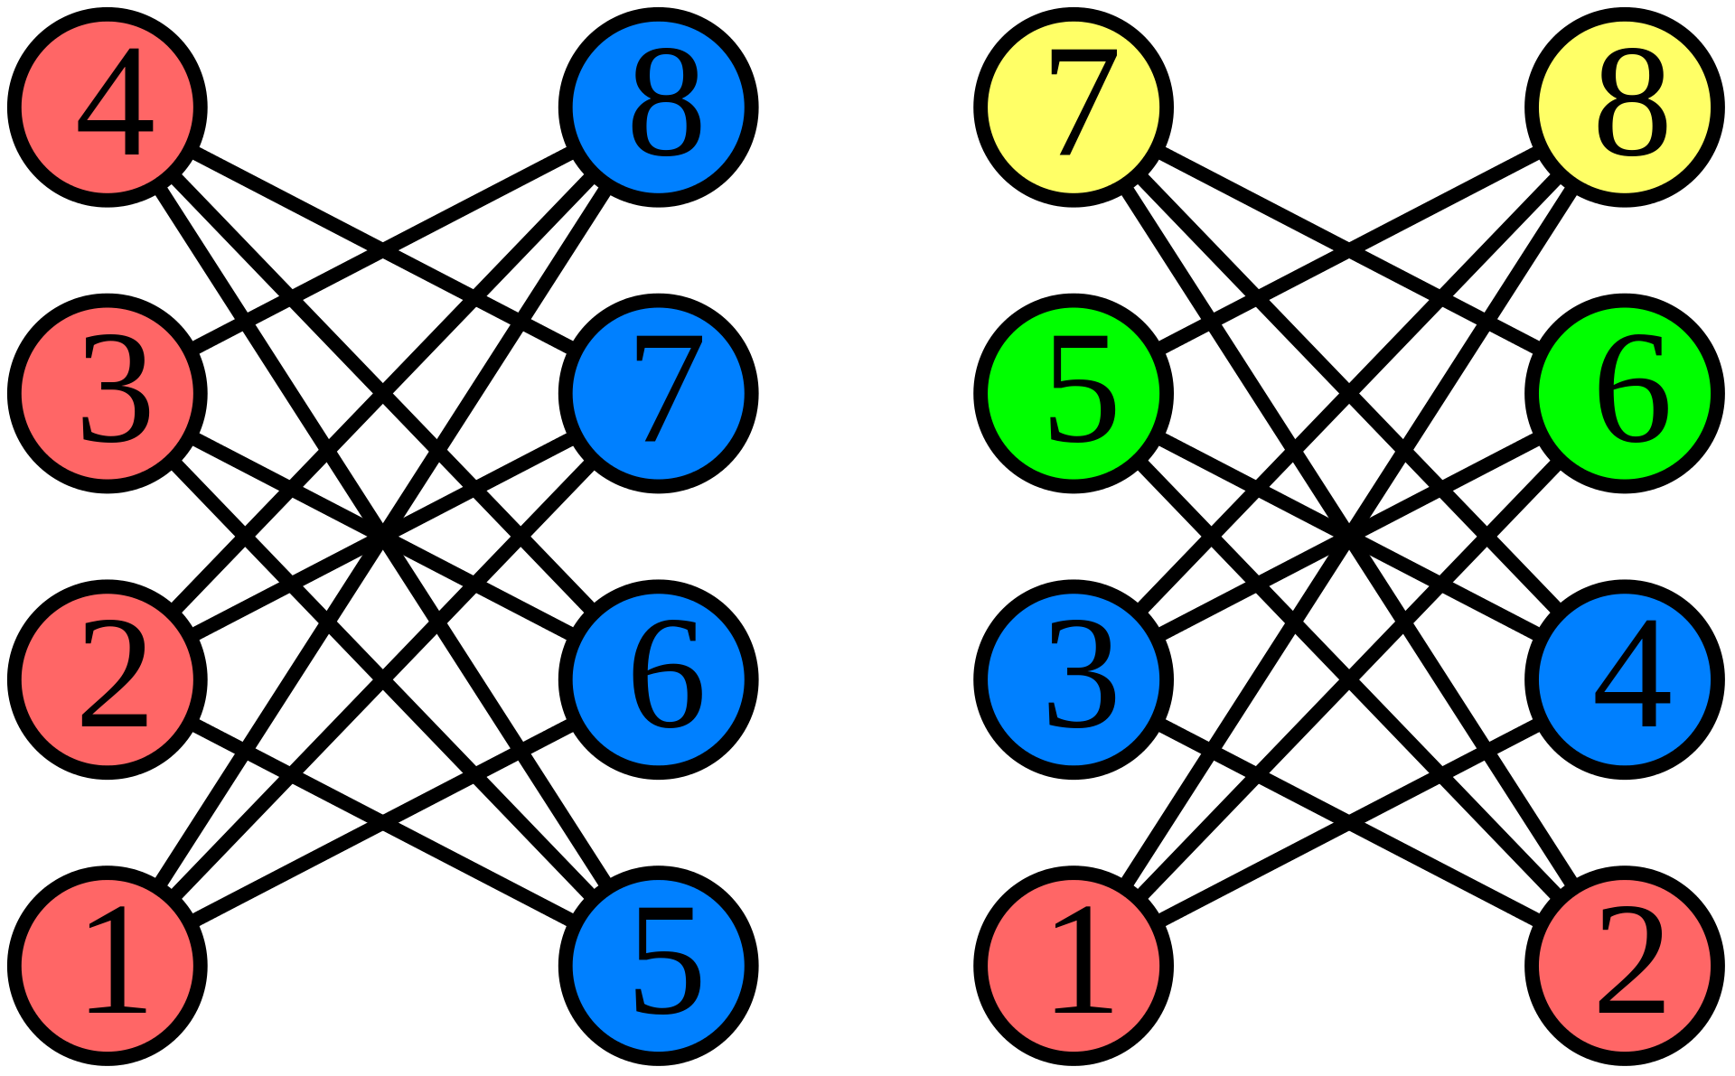
Analysis - Greedy graph coloring algorithm
Our algo creates a valid graph coloring.
But wait… aren’t greedy algorithms supposed to solve optimization problems?
Q: Does our algorithm ALWAYS produce graph colorings that have a minimal number of colors?
A: Nope! See example to the right.
So we should only use the greedy algorithm if we’re okay with a suboptimal solution.
Common issue with greedy algorithms: trades optimality for faster performance.
Optimal graph coloring vs worst greedy graph coloring for this bipartite graph.

Slide 58
Questions?

Slide 59
Reminder:
You have an HonorLock quiz due tonight by 11:59pm.

Slide 60
Extra Resources
Greedy:
https://www.geeksforgeeks.org/greedy-algorithms/
Huffman:
algorithm - Huffman Coding | algorithm Tutorial
Graph Coloring:
https://en.wikipedia.org/wiki/Graph_coloring
https://www.geeksforgeeks.org/graph-coloring-set-2-greedy-algorithm/

